Slide 1
Controlling Car with hand motion
Embedded System Diploma Graduation Project

Slide 2
Controlling Car with hand motion
Group : ALEX-23
Group Members :
Mahmoud Hussien
Rabeh Mohamed
Jumana Emad
Omar Ibrahem
Mahmoud Elghobashy

Slide 3
Summary
Technology is present in our lives on daily basis, Microcontrollers play important part in our life. Most Electronic devices have some microcontrollers in it. We have learned many concepts of microcontrollers especially ATMEGA
So to implement those concepts we had to make Controlling Car with hand motion Using ATMega and flex sensors

Slide 4
Short Breif
Controlling Car with hand motion is a robot which can be controlled by human gestures. The user just needs to wear a hand glove in which a flex sensor is included. The flex sensor will record the movement of the finger in a specific direction which will result in the motion of the car in the respective directions. We can control the car using flex sensors connected to a hand glove. flex sensor will allow the user to control the throttle of the car. Movement of car is controlled by mechanism which involves rotation of forth and rear wheels using motors.

Slide 5
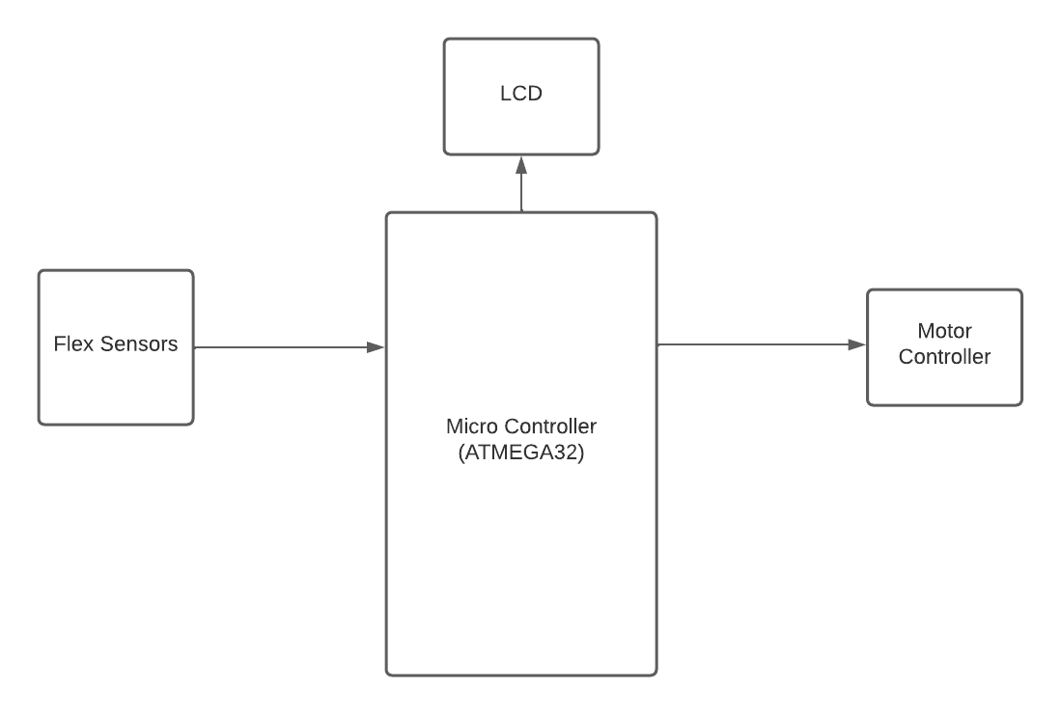
Block Diagram

Slide 6
Components Used
ATMega 32 Microcontroller
4x Flex Sensors
Voltage Regulator LM7805
2x Battery 3.7 V
L293D
10k Resistor
DC-Motors

Slide 7
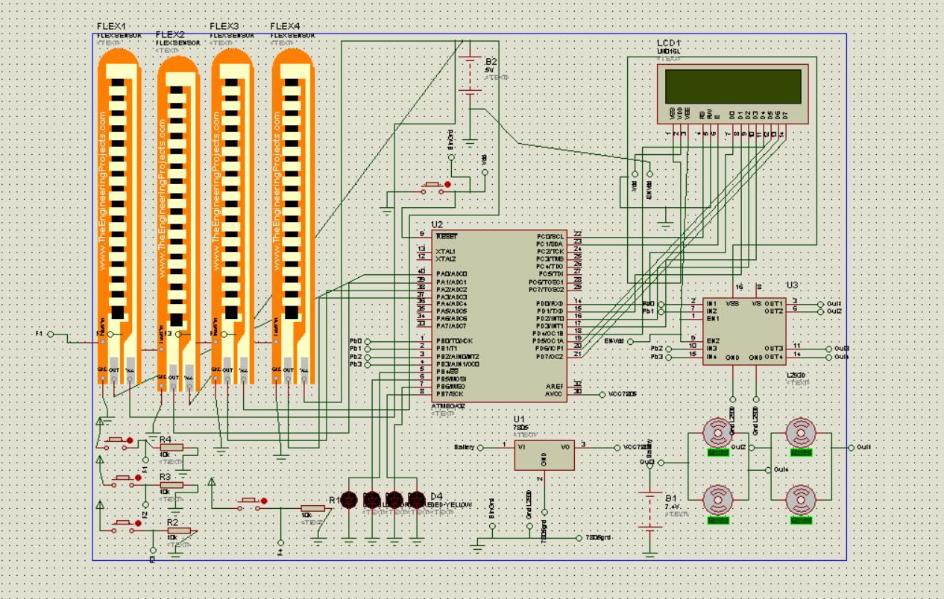
Circuit

Slide 8
Github Link
https://github.com/mahmudhmh/Controlling-Car-with-hand-motion

